Slide 1



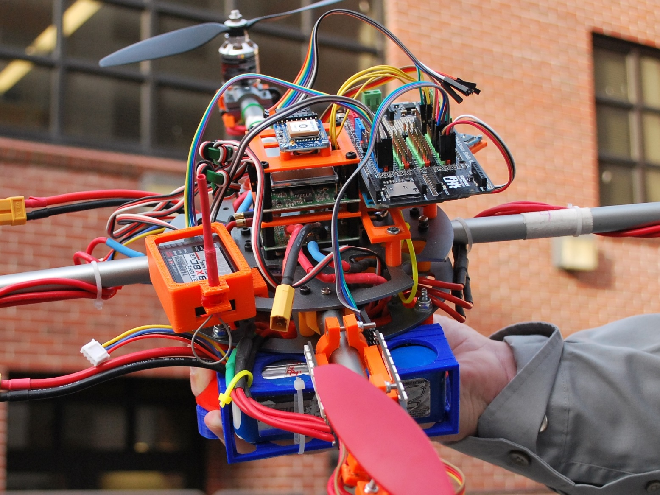
MISSION CONTROL
The Team
Making a Flight Plan
Members
David Klingenberg – CS
Taylor Trabun – CS
Emeth Thompson – CS
Joe Higley – CS
Advisors
Bruce Bolden
Robert Rinker
Client
Brandon Ortiz
The Mission
Sending a Flight Plan
To design and construct a stable and flying quadcopter and, a remote communications systems to send flight plans to the drone and receive in-flight drone vitals. In addition, a flight planning and monitoring software that is capable of developing 3D flight plans and summarize status of the drone during flight.
Project Learning
Drone Hardware
Some initial issues were drifting during flight due to misaligned center of gravity. A part holder was designed to center the distribution of weight. The part holder was printed at a lower density plastic to minimize the added weight it would contribute.
Communications
Our system requires two-way communication between computer and the Arduino located on the drone. This system takes an instruction created on the computer, sent over serial to the connected Arduino, pass it to XAPI, XAPI then ships it over XBee to the Arduino on the drone. A flight control service then executes the instruction.
Mission Planner & Flight Monitoring
The planning/monitoring software was developed using C#. C# is widely used and a lot of open source programs were referenced in the making of this software. The planner allows for the development and transfer of 3D mission plans. When the drone is in flight its coordinates and flight details are updated in an instrument panel and coordinate system.
A

